Slide 1

Poisson Regression – Part 2
Nina Gunnes
March 4, 2021

Slide 2
Mortality in relation to smoking
Using data on smoking status and death
Based on previous publication
  Doll R, Hill AB. Mortality of British doctors in relation to smoking: observations on coronary thrombosis. Natl Cancer Inst Monogr. 1966;19:205–268.
Part of the British Doctors Study (1951–2001)
  Follow-up of approximately 40,000 British medical doctors
  Questionnaire about smoking habits
  Association of smoking with lung cancer and other diseases

Slide 3
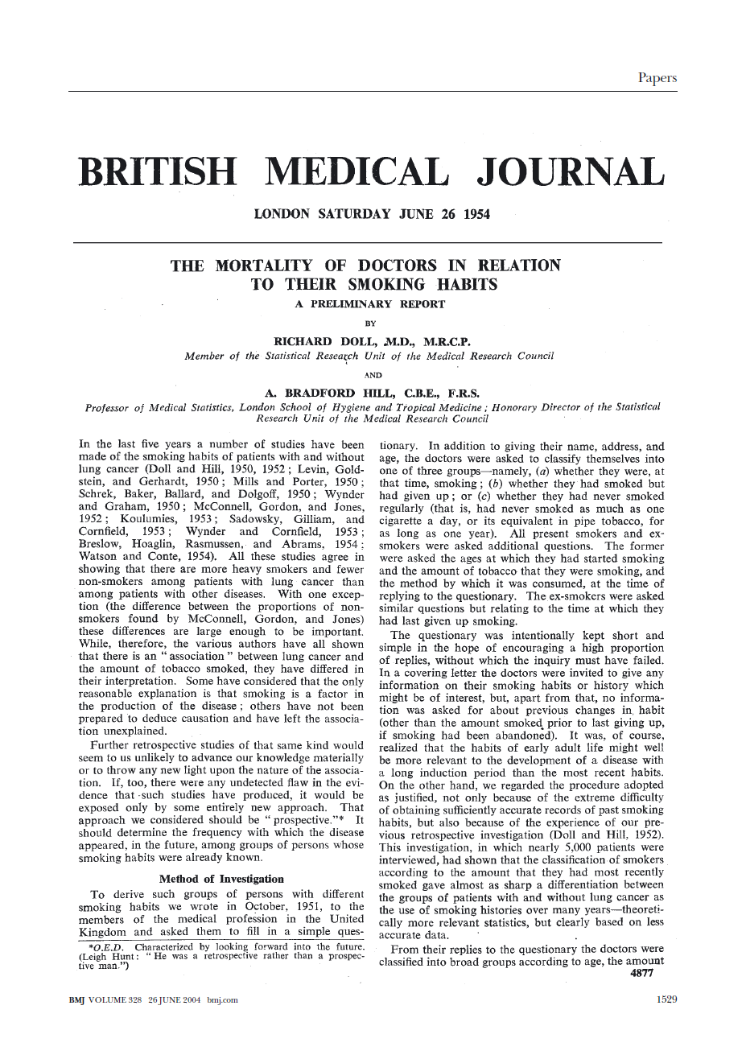
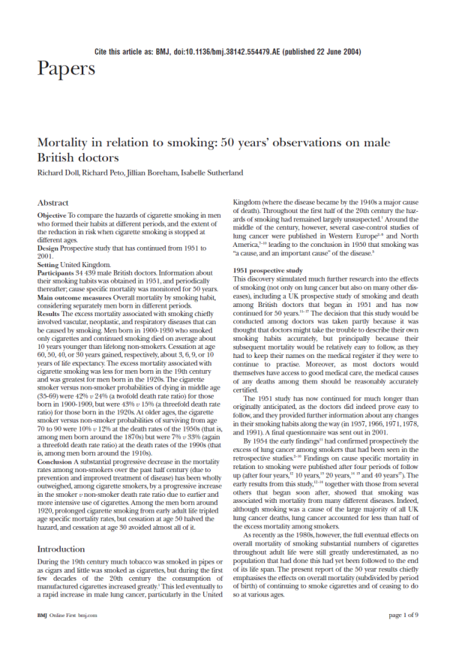
Mortality in relation to smoking, cont.

Slide 4
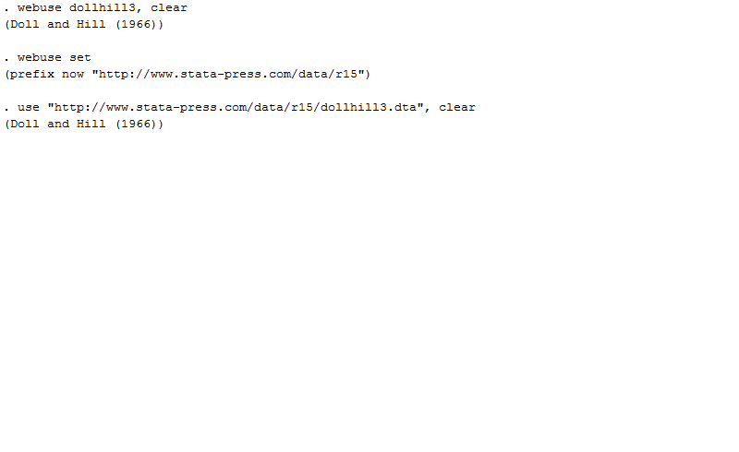
How to do it in Stata: Data load
Using webuse command
Data available on Stata’s website
  https://www.stata-press.com/data/
Loading data set over the web
  Name: dollhill3

Slide 5
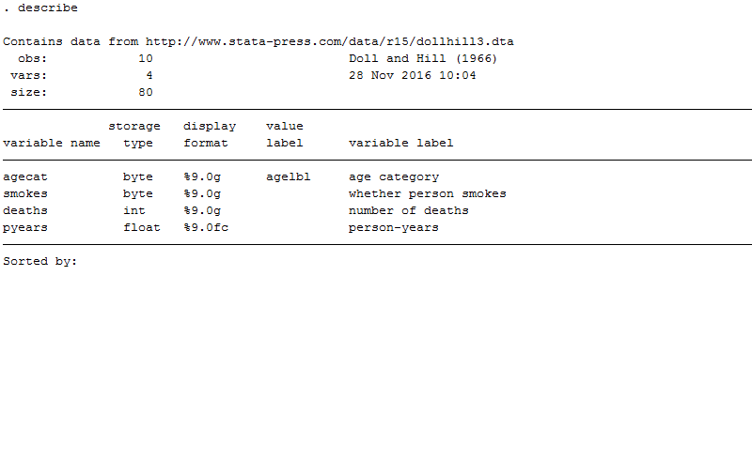
How to do it in Stata: Data inspection
Using describe command
Describing data in memory
  Summary of the data set

Slide 6
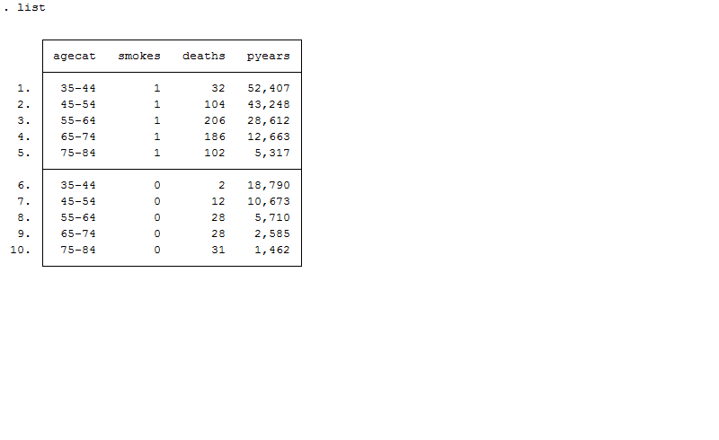
How to do it in Stata: Data inspection, cont.
Using list command
Listing values of variables
Interpreting person-time
  End time minus inclusion time

Slide 7
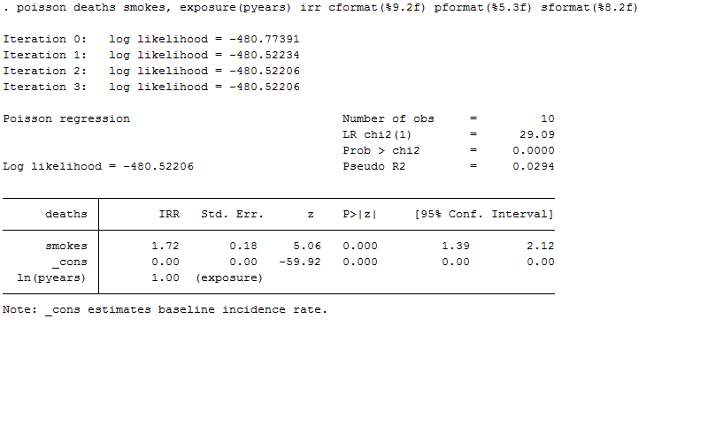
How to do it in Stata: Crude analysis
Using poisson command
Fitting a simple Poisson model
  Outcome: deaths
  Person-time: pyears
  Exposure (dichotomous): smokes
Interpreting the results
  72% higher risk among smokers

Slide 8
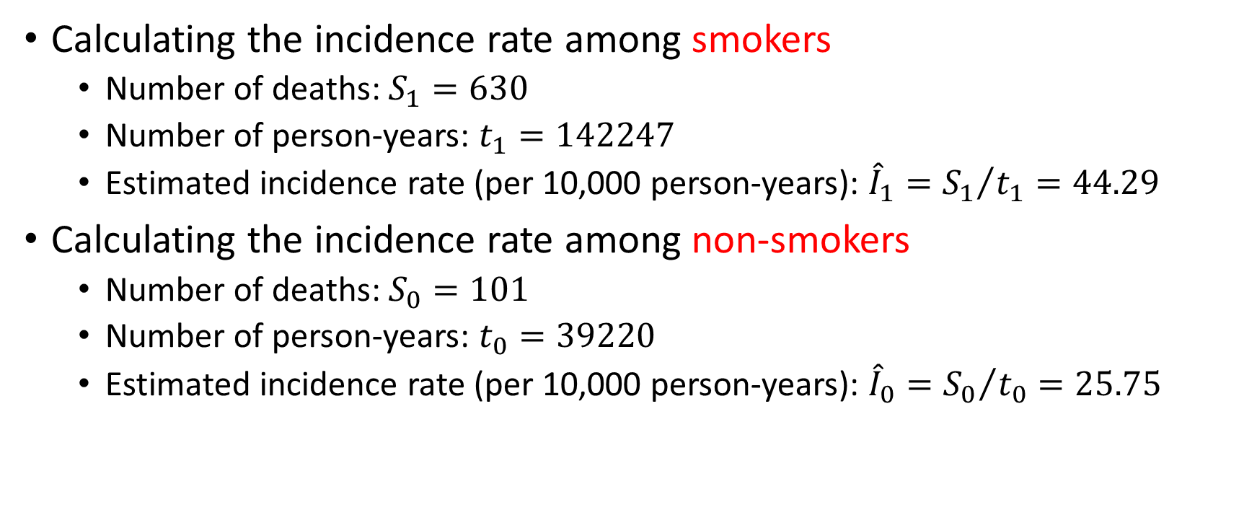
How to do it in Stata: Crude analysis, cont.
Calculating the incidence rate among smokers
  Number of deaths: $S_{1}=630$
  Number of person-years: $t_{1}=142247$
  Estimated incidence rate (per 10,000 person-years): ${\hat{I}}_{1}={S_{1}}/{t_{1}}=44.29$
Calculating the incidence rate among non-smokers
  Number of deaths: $S_{0}=101$
  Number of person-years: $t_{0}=39220$
  Estimated incidence rate (per 10,000 person-years): ${\hat{I}}_{0}={S_{0}}/{t_{0}}=25.75$

Slide 9
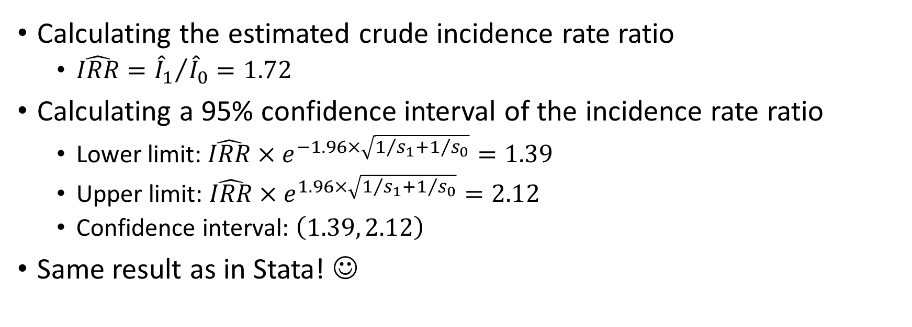
How to do it in Stata: Crude analysis, cont.
Calculating the estimated crude incidence rate ratio
  $\hat{IRR}={{\hat{I}}_{1}}/{{\hat{I}}_{0}}=1.72$
Calculating a 95% confidence interval of the incidence rate ratio
  Lower limit: $\hat{IRR}×e^{−1.96×\sqrt{1/{s_{1}}+1/{s_{0}}}}=1.39$
  Upper limit: $\hat{IRR}×e^{1.96×\sqrt{1/{s_{1}}+1/{s_{0}}}}=2.12$
  Confidence interval: $\left(1.39, 2.12\right)$
Same result as in Stata! ☺

Slide 10
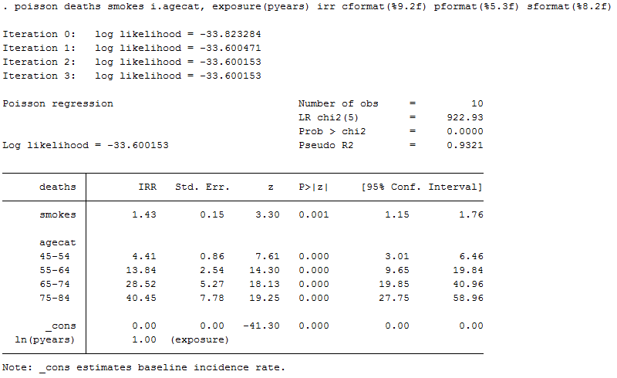
How to do it in Stata: Adjusted analysis
Using poisson command
Fitting a multiple Poisson model
  Outcome: deaths
  Person-time: pyears
  Exposure 1 (dichotomous): smokes
  Exposure 2 (categorical): agecat
Interpreting the results
  43% higher risk among smokers

Slide 11
How to do it in Stata: Dummy variables
Using generate and replace commands
Creating dummy variables (indicator variables) for age categories
  Reference: age category 35–44
  Dummy variable 1 (age category 45–54): agecat_45_54
  Dummy variable 2 (age category 55–64): agecat_55_64
  Dummy variable 3 (age category 65–74): agecat_65_74
  Dummy variable 4 (age category 75–84): agecat_75_84
Dummy variable equal to 1 if in relevant age category, 0 otherwise

Slide 12
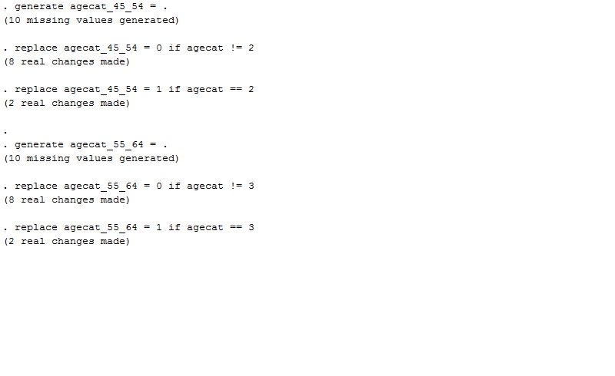

How to do it in Stata: Dummy variables, cont.

Slide 13
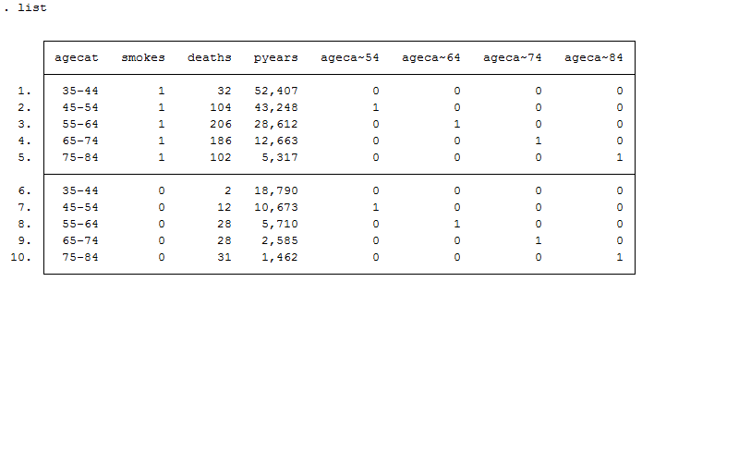
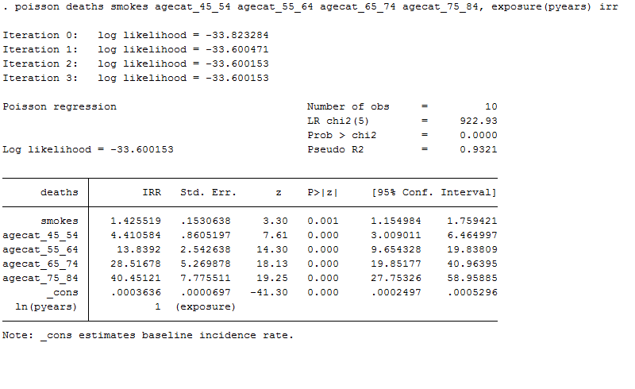
How to do it in Stata: Dummy variables, cont.

Slide 14
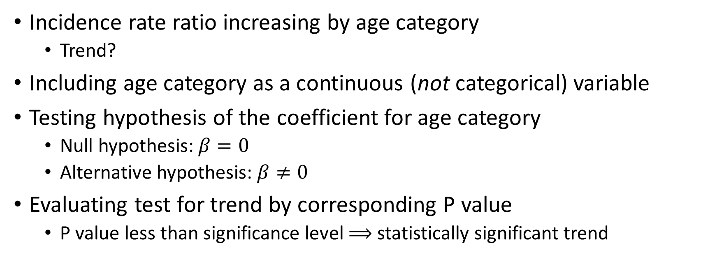
How to do it in Stata: Test for trend
Incidence rate ratio increasing by age category
  Trend?
Including age category as a continuous (not categorical) variable
Testing hypothesis of the coefficient for age category
  Null hypothesis: $β=0$
  Alternative hypothesis: $β≠0$
Evaluating test for trend by corresponding P value
  P value less than significance level $⟹$ statistically significant trend

Slide 15
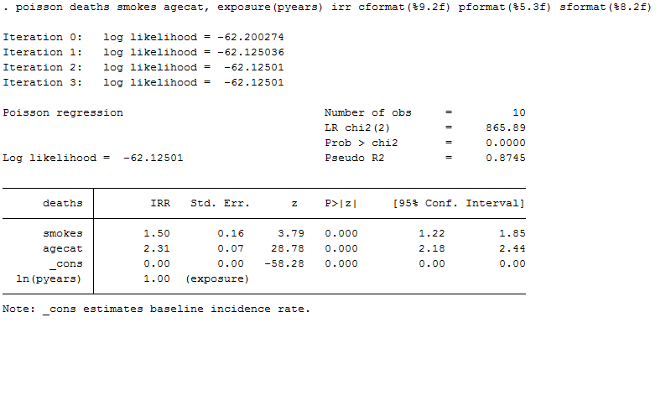

How to do it in Stata: Test for trend, cont.
Inspecting results
  Incidence rate ratio: $\hat{IRR}=2.31$
Statistically significant trend
  P value: $p<0.001$

Slide 16
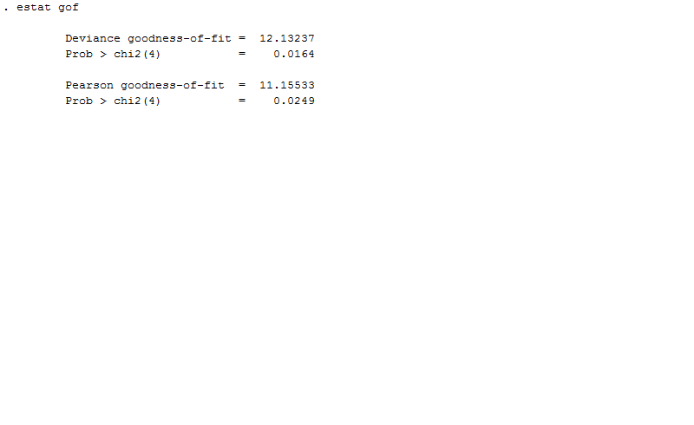
How to do it in Stata: Goodness of fit
Using estat gof command
  Based on LAST (!) fitted model
Fitting multiple Poisson model
  Age as categorical variable
  See slide 10
Performing a goodness-of-fit test
  Deviance
  Pearson

Slide 17
References
Aalen OO, Frigessi A, Moger TA, Scheel I, Skovlund E, Veierød MB. Statistiske metoder i medisin og helsefag. Oslo: Gyldendal akademisk; 2006.
Laake P, Hjartåker A, Thelle DS, Veierød MB. Epidemiologiske og kliniske forskningsmetoder. Oslo: Gyldendal akademisk; 2007. https://www.med.uio.no/imb/forskning/publikasjoner/boker/2007/epidemiolgiske-kliniske-forskningsmetoder.html.

